Slide 1

Echoed Nights By: Landon Armstrong
Group – New Game Horror

Slide 2
Goal of Echoed Nights
The purpose of this project is to develop a first-person POV horror game set in an environment filled with enemy AI monsters. X number of in-game nights, where the player must complete objectives, uncover the story, and evade attacks from monsters
These AI monsters will feature various mechanics such as roaming, chasing, triggering events, setting traps, and more. A unique aspect of the game is the adaptive nature of these monsters, learning from the player's decisions and patterns. This dynamic AI ensures that players cannot rely on repeating the same techniques to easily overcome each night's challenges, adding depth and tension to the gameplay.

Slide 3
Why is this Being Built?
Growth of A.I in todays world
A.I incorporation in Horror Genre is not as popular compared to other genres
Reinforcement learning is seen little to none in horror genre
Knowledge w/ Unity – Horror is a good basis
Something passionate about

Slide 4
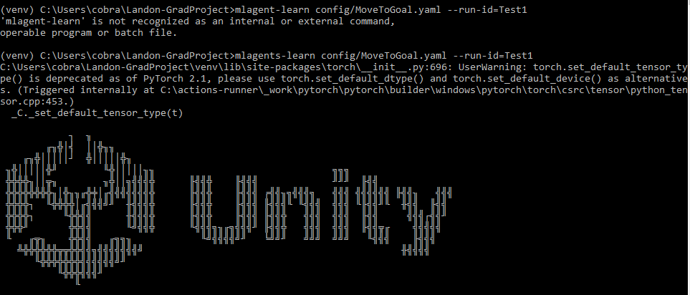
What is Used
Unity – Version 2022.3.18f1
Visual Studio 2022 – C#
PyTorch is an open source library for performing computations using data flow graphs, the underlying representation of deep learning models. It facilitates training and inference on CPUs and GPUs in a desktop, server, or mobile device.
Unity Asset Store
Unity Mlagents
TypeCase.ai – intro voice

Slide 5
How the Goal is Achieved - AMEP
A – Adaptative AI Implementation: applying reinforcement learning in Unity
M – Multiple monsters: variety of monsters and behaviors to make each night a new and tougher experience. Monsters consists of reinforcement learning agents and NavMeshAgent
E – Extended Night Cycle: Several in-game nights in the same environment
P – Player-drive gameplay: Through reinforcement learning and adaptative behaviors, encourages player to shape their own experience. The adaptive AI system ensures that no two playthroughs are exactly alike, offering a high degree of replayability and unpredictability

Slide 6
Original Schedule
Phase 1: Planning (January 20th - February 10th)
Conceptualization and Design
Pre-production
Phase 2: Development (February 11th - March 20th)
Core Mechanics and Prototyping
Environment and Level Design
AI Development
Phase 3: Testing (March 21st - April 10th)
Gameplay Testing
AI Testing
Phase 4: Polishing (April 11th - April 24th)
Optimization

Slide 7
What Got Pushed Back?
Core Mechanics and Prototyping – further understanding of mechanics, collisions, and physics
AI Development – reinforcement learning unfortunately is incomplete
Gameplay Testing – AI Development pushed everything back
AI Testing - Untested

Slide 8
Obstacles
Asset selection – Unity Asset store
Demonstration videos are outdated – commands, packages, etc. aren’t compatible
Relearning and new learning
Reinforcement learning training was the biggest issue – environment size & reward system perfection
New experience

Slide 9
Similarities
Five Nights at Freddys – Extended Night Cycle, Multiple Monster
Alien Isolation (A.I) – Director A.I feeds info to Alien A.I – Behavior tree
F.E.A.R (A.I) – Behavior Tree
Little to none A.I horror games
KAGIDOKO is an experimental horror game. Collect all keys, open all doors, and get out of that house... While being stalked by a pre-trained Deep Learning Gameplay AI.

Slide 10
Side Notes
ONNX (Open Neural Network Exchange) format. ONNX is an open format for representing deep learning models that enables interoperability between different deep learning frameworks, such as TensorFlow, PyTorch, and MXNet.
The ".onnx" extension indicates that the file contains a neural network model, including its architecture, parameters, and possibly other metadata.
configuration.yaml" file is a common configuration file used in various software applications and systems, especially those based on YAML (YAML Ain't Markup Language), which is a human-readable data serialization format.

Slide 11
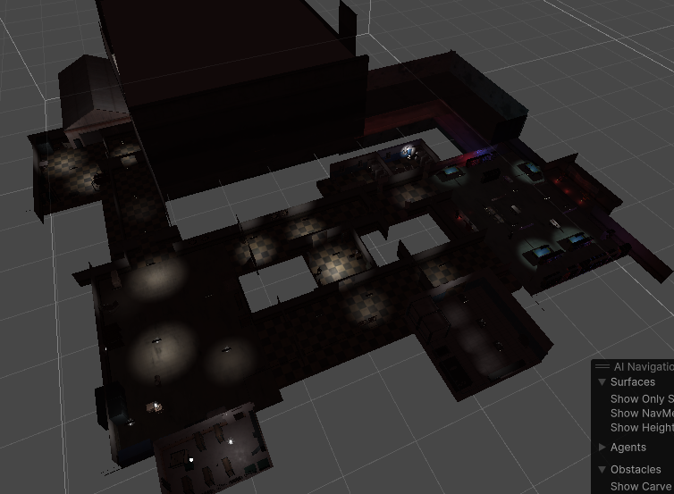
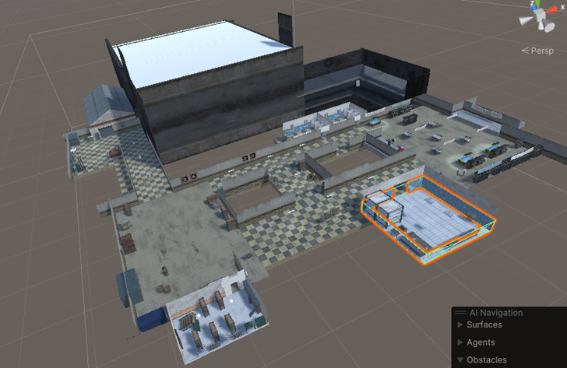
Environment

Slide 12
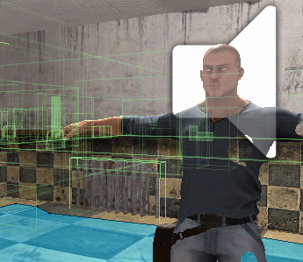
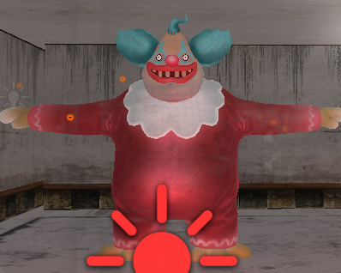
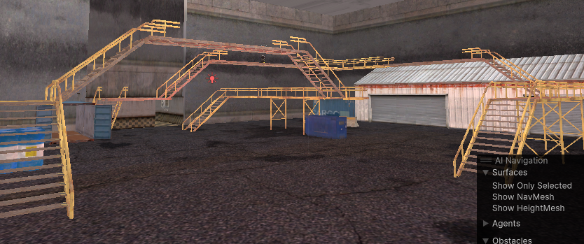
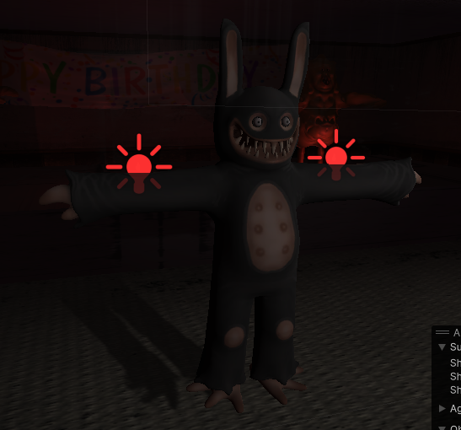
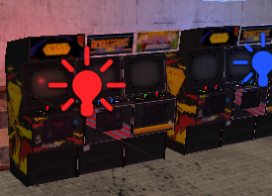
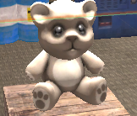

Slide 13

Training

Slide 14
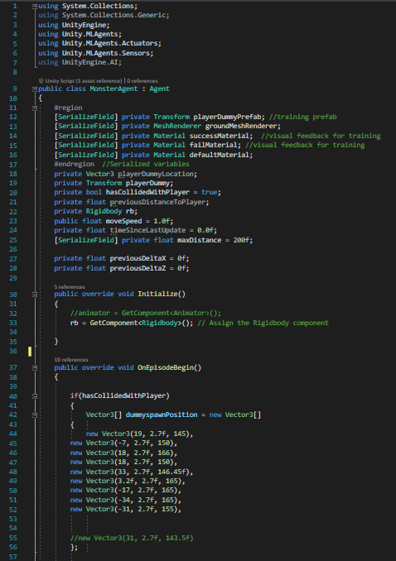
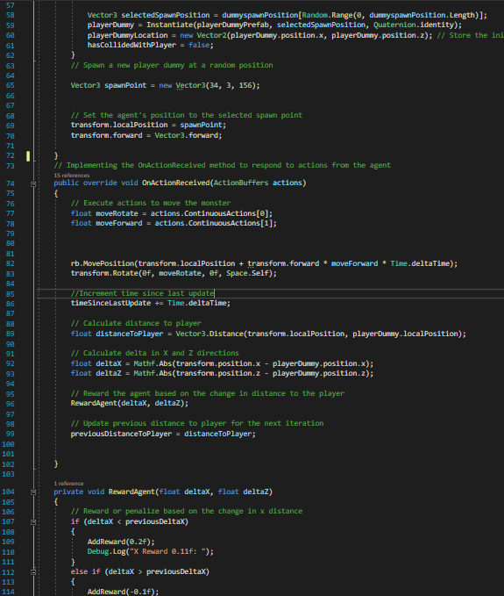
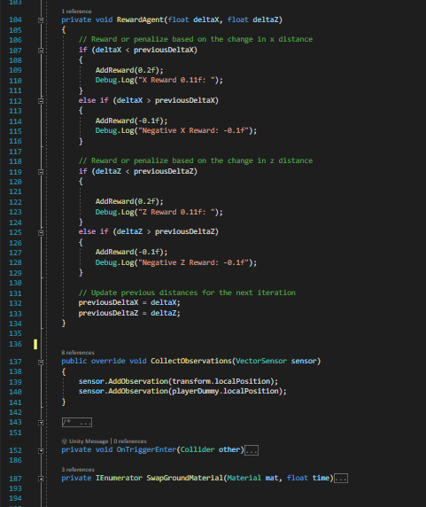
Scripts

Slide 15
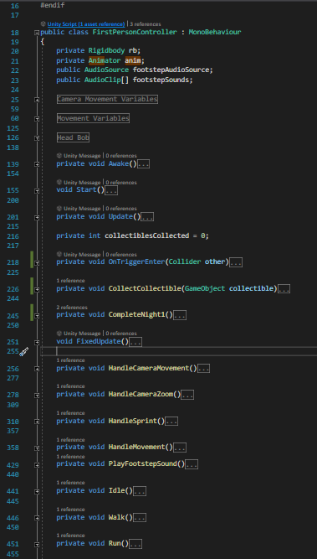
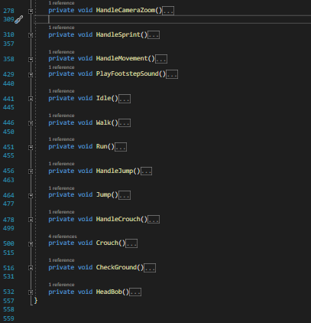

Slide 16
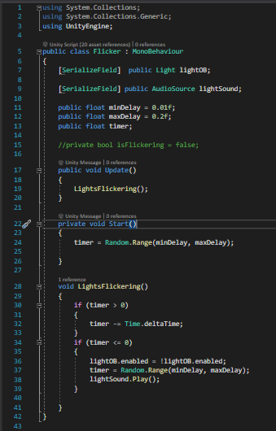
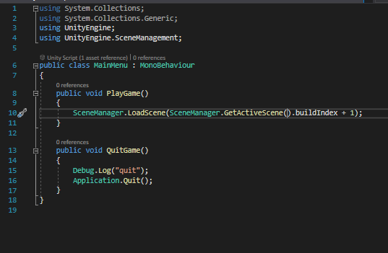

Slide 17
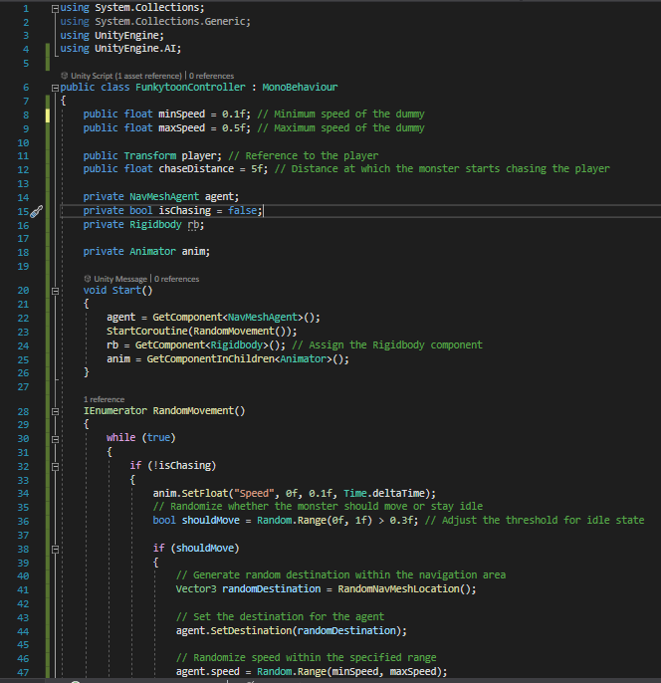
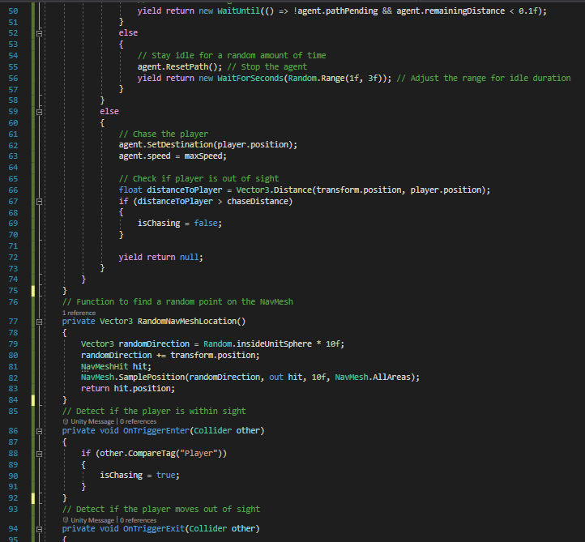

Slide 18
Future Plans
Reinforcement learning needs to be tested further and possible receive insight
Animation
Additional levels/nights
Collisions/physics critique
Feedback on atmosphere – horror genre
Fine tune gameplay mechanics
Publish

